Slide 1
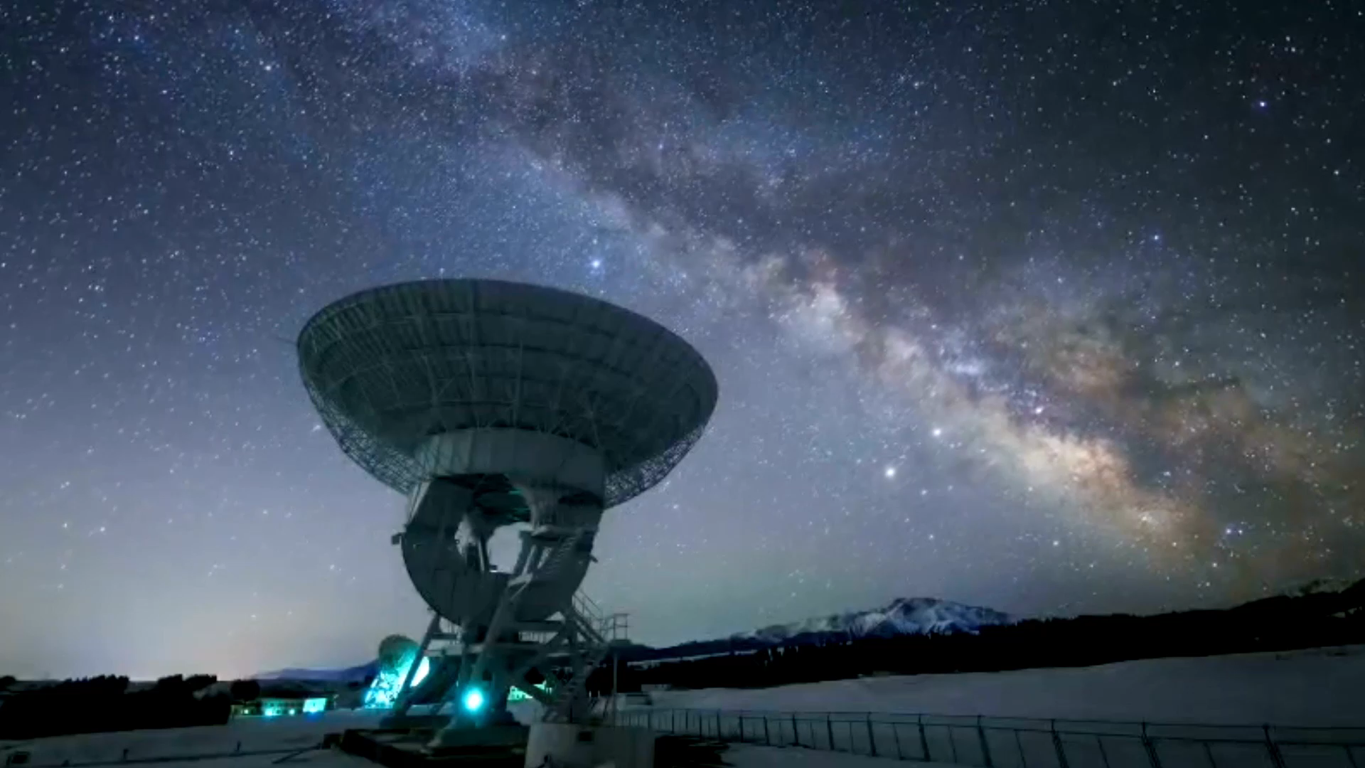
Team Galactic: Alien Invasion Simulation
Joseph Lumpkin, Zachery Powers, Rocky Trinh, Vincent Capra

Slide 2
Main Idea
Using Android Studio
A grid is generated with 10 X 10 tiles, 30 % become water
Resource tiles are spawned for: Uranium, Oil, Iron, and 1-Up Mushrooms
Humans and Martians are spawned in at lopsided populations
Humans can reproduce but Martians cannot
Simulation purpose:
The Martians attempt to gather resources to build a doomsday device! The Humans hunt the Martians and try to eradicate them because they know backup cannot arrive from Mars in time! If the humans can eradicate them, they can steal the plans for the doomsday device to defend against a future invasion!

Slide 3
Patterns used:
Vincent
Abstract Factory
Template
Singleton
Strategy
Composite
Enumeration
Joe
Strategy
Iterator
Observer
Rocky
Iterator
Enumeration
Strategy
Zach
Singleton
Memento
Observer
Prototype
Visitor
Iterator

Slide 4
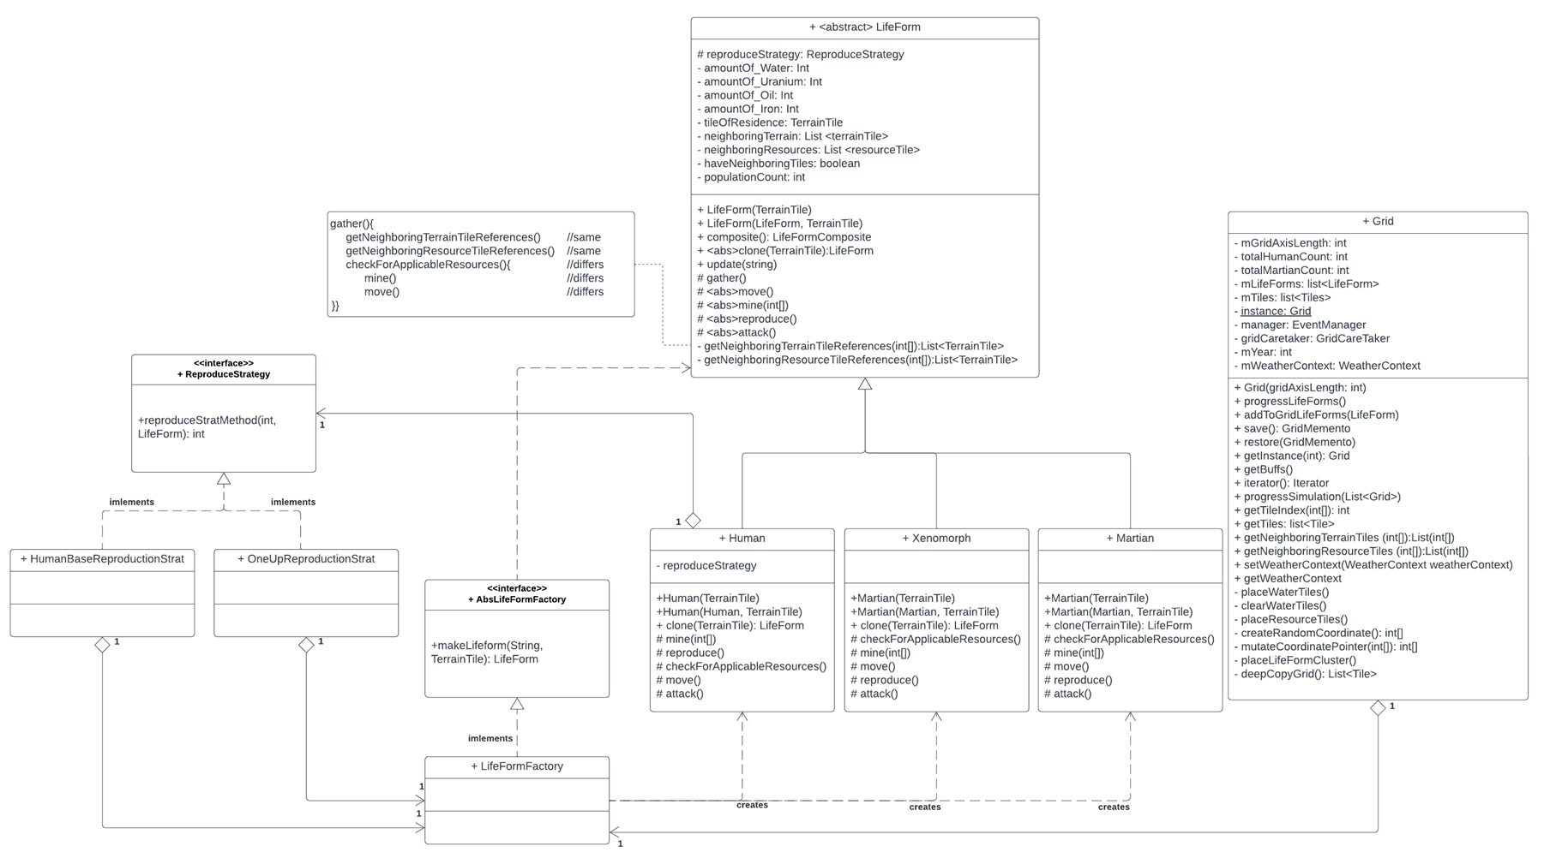
Abstract Factory, Template, & Strategy – Vincent Capra

Slide 5
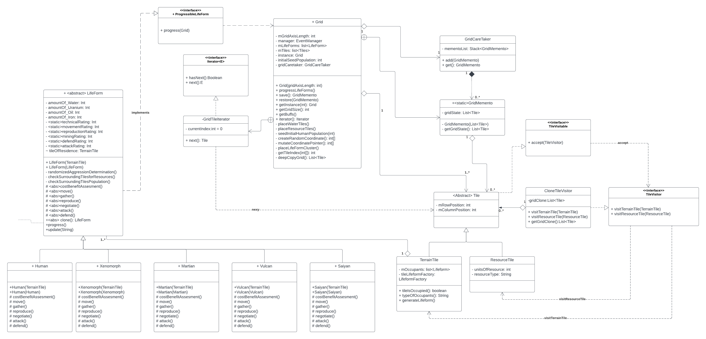
Prototype, Visitor, Iterator, Memento – Zack Powers

Slide 6
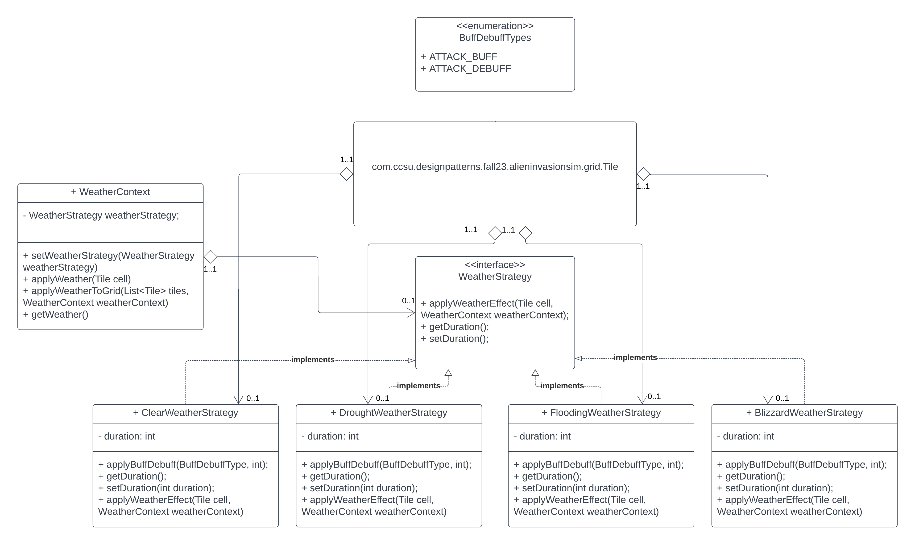
Strategy and Enumeration – Rocky Trinh

Slide 7
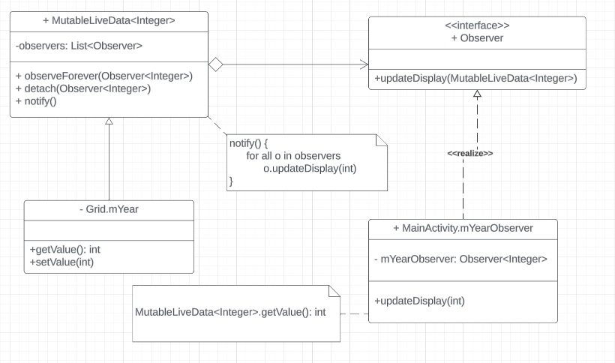
Observer – Joseph Lumpkin

Slide 8


